Slide 1
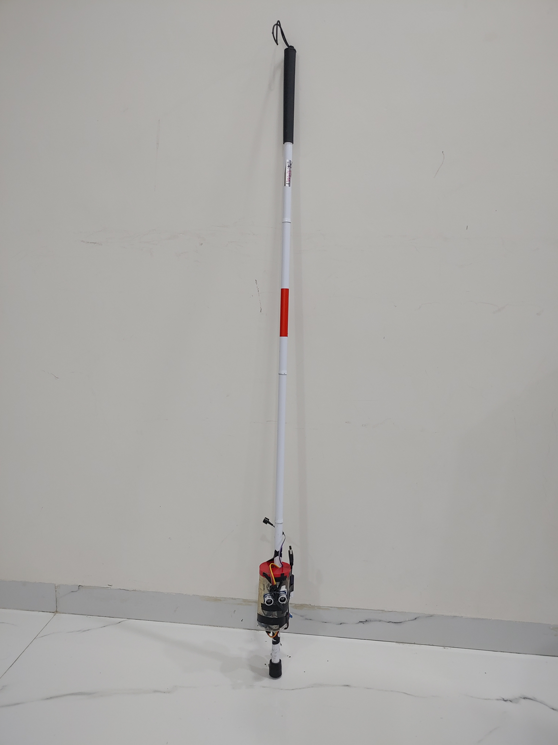

Ultrasonic VISION for Blind
PRESENTED BY
GANGOTRI DATTA KOMPALWAR

Slide 2
Introduction
India has over 4.6 million people with visual impairments. They face numerous small and large accidents while walking. Identifying this problem, this project has been selected.
In this project an ultrasound device is used to detect distance of object in front of a person.
An Arduino is programmed along with buzzer which works as commands for blind person to stop before obstacles.

Slide 3
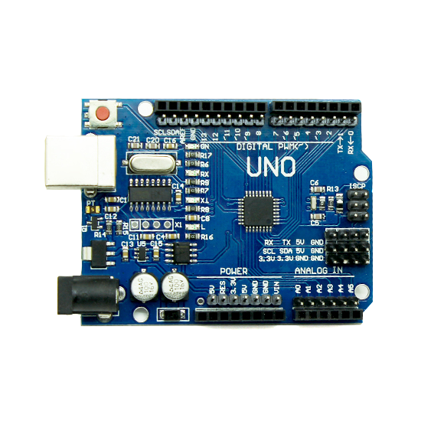
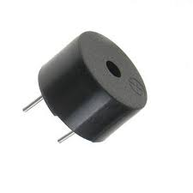
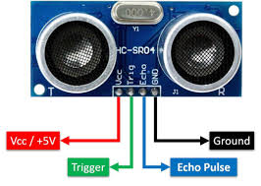
Components Used
Ultrasonic Sensor HC-SR04[2]
Buzzer
Connecting Wires
Arduino Uno[1]
9V Battery
Blind Stick

Slide 4
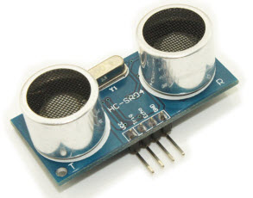
1.Ultrasonic sensor
It is designed to measure the distance of any object by using an ultrasonic transducer. Ultrasonic means of distance measurement is a convenient method compared to traditional one using measurement scales.
This kind of measurement is particularly applicable to inaccessible areas where traditional means cannot be implemented such as high temperature, pressure zones etc.
It is designed to measure the distance of any object by using an ultrasonic transducer.
Ultrasonic means of distance measurement is a convenient method compared to traditional one using measurement scales.
This kind of measurement is particularly applicable to inaccessible areas where traditional means cannot be implemented such as high temperature, pressure zones etc.

Slide 5
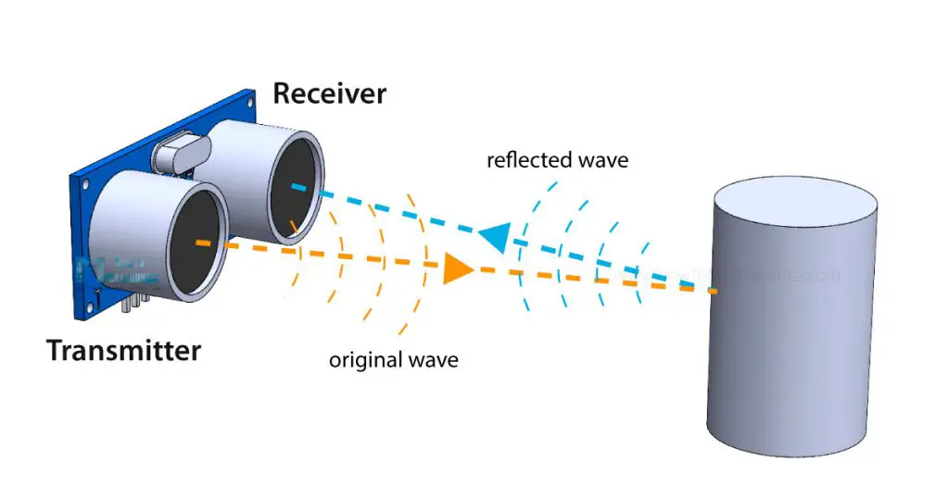
Distance Measurement by ultrasonic sensor
An ultrasonic transducer comprising of a transmitter and receiver are used.
The total time taken from sending the waves to receiving it is calculated by taking into consideration the velocity of sound.
In this way distance is calculated.

Slide 6
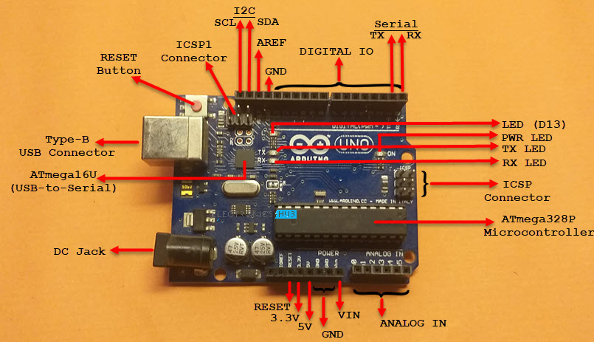
WHAT IS ARDUINO UNO AND HOW IT WORK ?
The C programming language is used to program microcontroller boards such as the Arduino Uno to interact with sensors, and other devices connected to the board.
In fact, the language is based on C++, and it is designed to be easy to use for beginners and non-programmers.
Additionally, it is commonly used in projects involving robotics, home automation, and Internet of Things (IoT) applications.

Slide 7
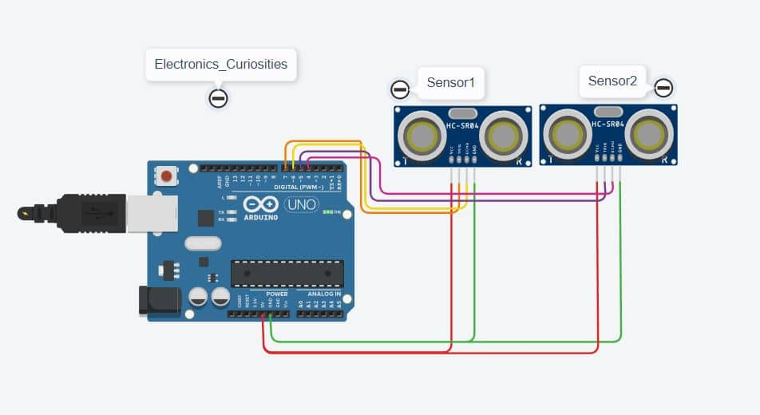
Working of Project
The project uses a pair of ultrasonic transducers comprising of 1 transmitter and 1 receiver.
When ever an obstacle obstructs the signals of ultrasonic transmitter it reflects the signal towards the ultra sonic receiver.
According to the distance measurement which is calculated the recorded voice will play over and blind person can be alerted for upcoming obstacle.

Slide 8
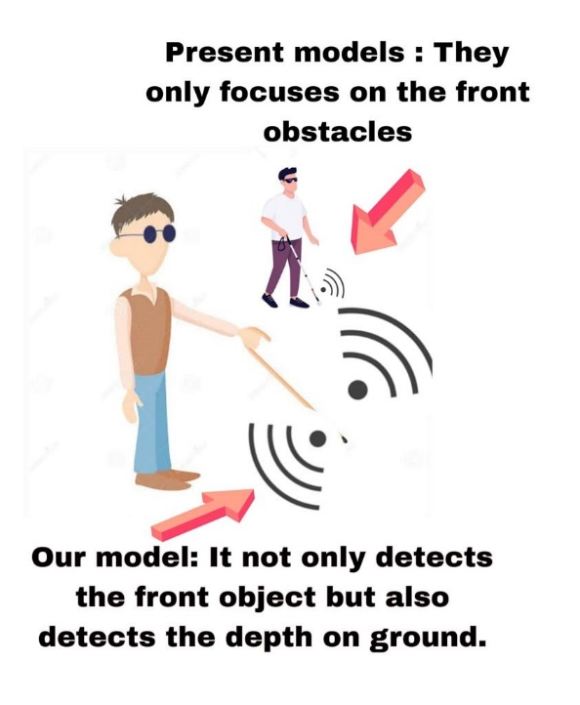
ADVANTAGES OVER PRESENT MODELS
1] This model not only focuses of front obstacles but also this model helps blind people from any type of accidental collision and falling to a depth, stairs, potholes etc.
2] All present models are focused only on front obstacles on the other hand this model also focuses on front obstacles and any type of depths.
3] The ISD used in this model helps to record and play personal voice commands so one can get aware before any obstacle or fall.
4] As this model is integrated in stick used by a blind person no extra load needed to carry it separately.
5] The model is cost effective as compared to its usability and utility.

Slide 9
Conclusion
Our project aimed to build a device which could help blind people detect objects in front of them and protect them from injury. For this, we have chosen an ultrasonic sensor as a distance measurement equipment, and A Buzzer is used to give two different sounds for two ultrasonic sensors, and Arduino programming with a breadboard circuit to coordinate between all devices.
And the buzzer will alert the blind person as it comes closer to an object beyond a certain limit.
This project will help to improve the quality of a blind person and may prove to be a life-saving device in critical condition.

Slide 10


